Slide 1

SKIN CANCER IMAGE CLASSIFICATION USING CNN AND VIT.
Manasa Chelukala
Notes:
Now-a-days,Skin cancer has became the most common human disease,which is primarily diagnosed visually,starting with an initial clinical screening and followed potentially by dermoscopic analysis,a biopsy & histopathological examinations.
usually,the skin cancer occurs due to the mutations caused in the DNA of the cells and these cells grow out-of-control and form a mass of cancer cells.
Well,here iam going to use cnn and vit in classifying the images and predicting the type of skin cancer and provide the comparison of both models in the prediction.
---Skin cancer detection through histopathology can be achieved by augmenting the power of deep learning. The classification of skin cancer lesions through specialized convolutional neural networks can help the medical community in detecting and possibly curing the disease at the early stages. Some early stipulations related to this cancer are discolouration or inflammation of the skin, itching and bleeding of skin patches, moles or red, waxy bumps on the skin due to the cancerous cells

Slide 2
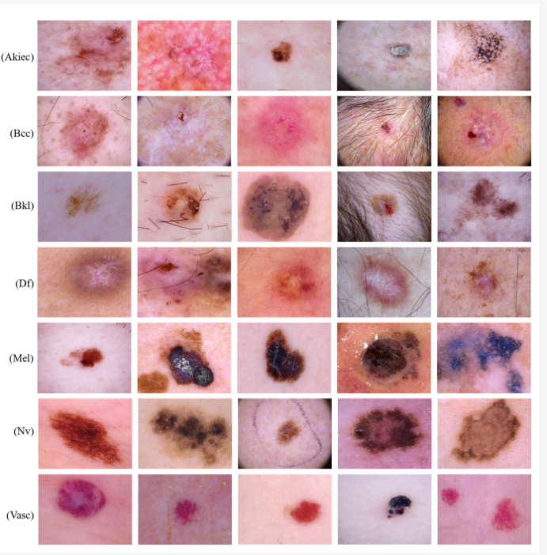
HAM10000 MNIST Dataset
Shape : (450 x 600 x 3)
Total images: 10015
Training Samples:10000
LABEL | DESCRIPTION
akiec | Actinic Kerastoses
bcc | Basal cell carcinoma
bkl | Benign Keratosis
df | Dermatofibroma
nv | Melanocytic nervi
mel | elanoma
vasc | Vascular skin lesions
Notes:
Here ,I will be using the images of 7 different classes of HAM-10000 MNIST Dataset from Kaggle i.e. akiec,bcc,… of 10000 training samples with a shape of 450/600/3

Slide 3
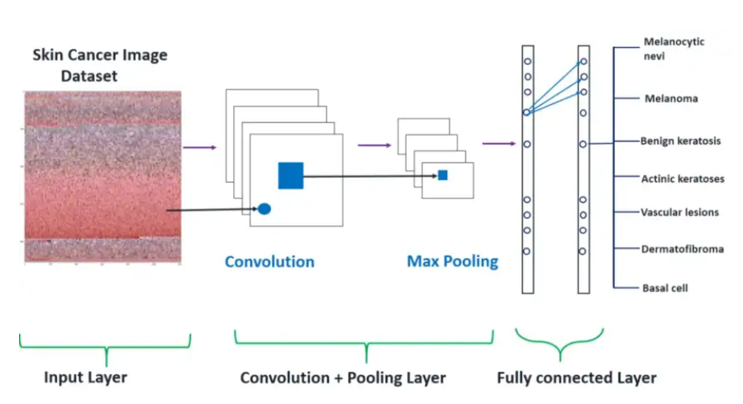
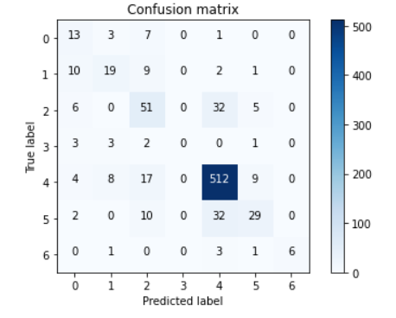
Skin Cancer Image classification using CNN
Input -> [[Conv2D -> relu] *2 -> MaxPool2D -> Dropout]*2 -> Flatten -> Dense -> Dropout -> Output
Notes:
Input -> [[Conv2D -> relu] *2 -> MaxPool2D -> Dropout]*2 -> Flatten -> Dense -> Dropout -> Output
Full description of model are as follows :
I used the Keras Sequential API, where you have just to add one layer at a time, starting from the input.
The first is the convolutional (Conv2D) layer. It is like a set of learnable filters. I choosed to set 32 filters for the two firsts conv2D layers and 64 filters for the two last ones. Each filter transforms a part of the image (defined by the kernel size) using the kernel filter. The kernel filter matrix is applied on the whole image. Filters can be seen as a transformation of the image.
The CNN can isolate features that are useful everywhere from these transformed images (feature maps).
The second important layer in CNN is the pooling (MaxPool2D) layer. This layer simply acts as a downsampling filter. It looks at the 2 neighboring pixels and picks the maximal value. These are used to reduce computational cost, and to some extent also reduce overfitting. We have to choose the pooling size (i.e the area size pooled each time) more the pooling dimension is high, more the downsampling is important.
Combining convolutional and pooling layers, CNN are able to combine local features and learn more global features of the image.
Dropout is a regularization method, where a proportion of nodes in the layer are randomly ignored (setting their wieghts to zero) for each training sample. This drops randomly a propotion of the network and forces the network to learn features in a distributed way. This technique also improves generalization and reduces the overfitting.
‘relu’ is the rectifier (activation function max(0,x). The rectifier activation function is used to add non linearity to the network.
The Flatten layer is use to convert the final feature maps into a one single 1D vector. This flattening step is needed so that you can make use of fully connected layers after some convolutional/maxpool layers. It combines all the found local features of the previous convolutional layers.
In the end I used the features in two fully-connected (Dense) layers which is just artificial an neural networks (ANN) classifier. In the last layer(Dense(10,activation=”softmax”)) the net outputs distribution of probability of each class.
From the above confusion matrix, we can say that the cancer type of number - 4 which is Melanocytic nevi has the highest number of correct prediction i.e., 512.

Slide 4
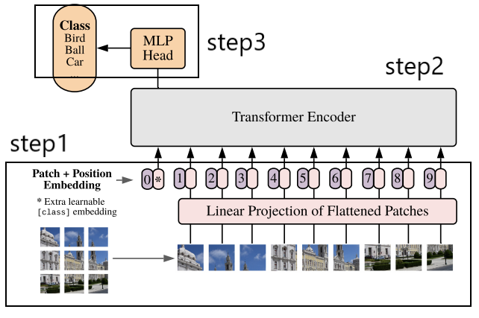
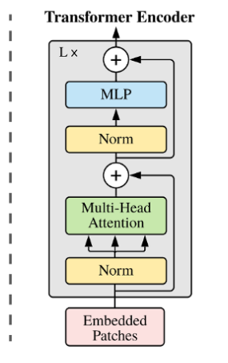
Architecture of Vision Transformer
Notes:
The Vision Transformer, or ViT, is a model for image classification that employs a Transformer-like architecture over patches of the image
Overview of the model: we split an image into fixed-size patches, linearly embed each of them, add position embeddings, and feed the resulting sequence of vectors to a standard Transformer encoder. In order to perform classification, we use the standard approach of adding an extra learnable "classification token" to the sequence.
Step 1: Split the image into fixed-size patches.
Step 2: Flatten the 2D image patches to 1D patch embedding and linearly embed them using a fully connected layer.
Step 3: Unlike other architectures, transformers have no idea of sequence or any positional information. So, we use the positional embeddings to the patches to retain positional information.
Step 4: Transformer Encoder has alternating layers of multiheaded self-attention and MLP blocks. Layernorm (LN) is applied before the self-attention block and the MLP block. The residual connections are applied after every block to avoid vanishing gradient problem(We can detect it by analysing the kernel weight distribution. There is a vanishing gradient if the weights are falling regularly near zero.). This block helps learn local and global dependencies in the image.
Step 5: A classification head is implemented using MLP with one hidden layer at pre-training time and a single linear layer for fine-tuning for image classification.

Slide 5
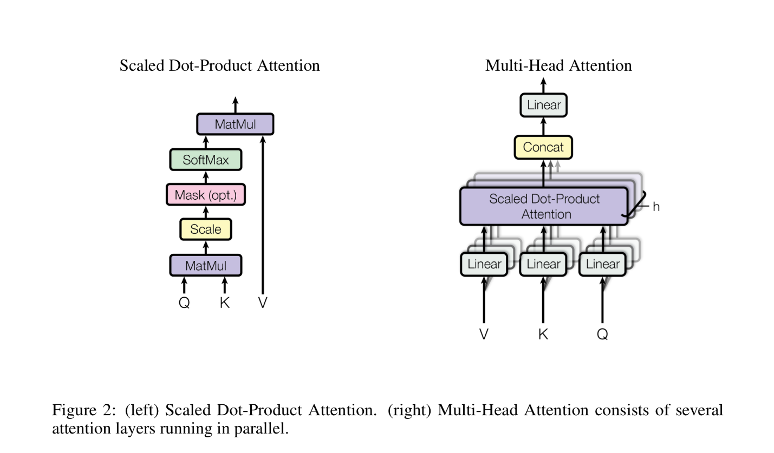
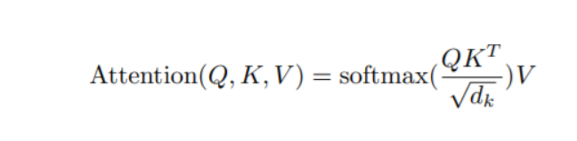
Transformers: Multi Head Self Attention
Notes:
The Multi-Head Attention layer split inputs into several heads so that each head can learn different levels of self-attention. The outputs of all the heads are then concatenated and passed through the Multi-Layer Perceptron.(It can be used to solve complex nonlinear problems. It handles large amounts of input data well. Makes quick predictions after training. The same accuracy ratio can be achieved even with smaller samples.)
The multiple attention heads help learn local and global dependencies in the image.
Self attention allows the input to interact with each other and generate the output

Slide 6
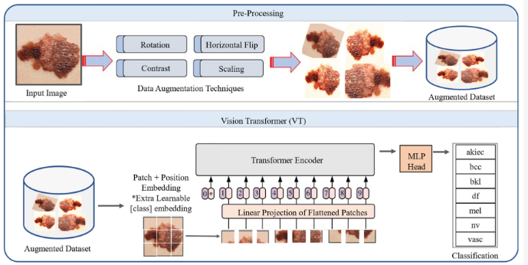
Skin Cancer image Classification framework
Notes:
Pre-processing of data is an important step in machine learning that enhances the quality of the data to be used. When training the CNN model on raw input data, for example, classification accuracy may decrease. Therefore, in the preprocessing stage, data augmentation is used to generate supplementary images from the existing images to vary their scale, position, orientation, contrast enhancement, and brightness adjustment as shown in figure.

Slide 7
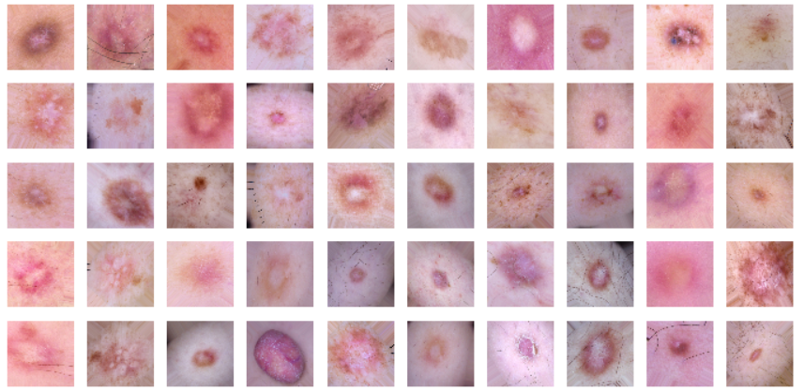
Step 1: Patch Encoder
Input Images (450,600,3)
Split Images into Patches (tf.image.extract_patches)
(Patch Size: 32, Number of patches: 224)
Flatten 2D images into 1D Patches using fully connected layer
Patch size: 32 X 32
Patches per image: 224
Patch Encoder
Projection(Patch)+ Positional Embedding
Shape(None,768,11)

Slide 8
Embedded Patches (No. of Patches, dim)
Layer Normalization
Residual
Multi Head Attention(12 Heads)
12 Transformer Layers
Layer Normalization
Residual
2 layer MLP
Layer Normalization
(No.of Patches, dim)
Flatten

Slide 9
Step3: Dense Network (Classifier)
Flattened Output from Transformer Encoder
MLP (3072, 768)
Classifier(Dense Network)
(None, 7)

Slide 10
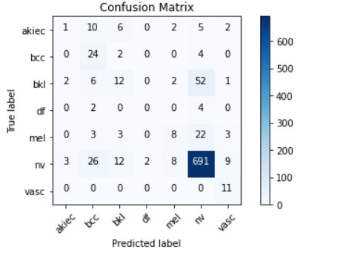
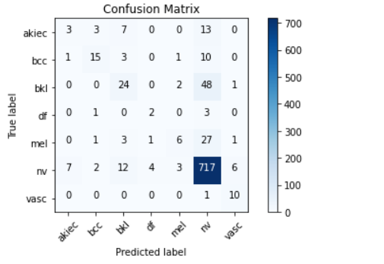
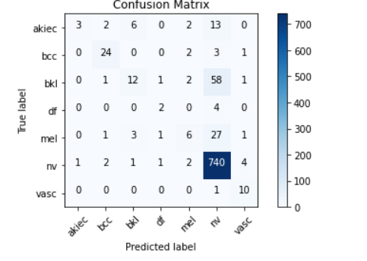
Confusion Matrix
Vit B_32
Vit B_16
Vit B_16 – Fitted model
Notes:
Using the patch size of 16 and using the optimizer sgd and activation function Gelu the model predicted well the type of cancer so I have fitted this model and evaluated its performance on the classification of skin cancer

Slide 11
CNN vs Transformers
CNN | Transformers
Feature Map | Attention map
Pixels | Patches
Doesn't Outperforms on large datasets | Outperforms CNN over large datasets
Batch Normalization | Layer Normalization
Strided convolution to change spatial dimension an input shape | complex transformation beyond simple scaling - MLP
Notes:
CNNs use 3x3 or 5x5 size kernels, so each layer can only have a corresponding field of view. And the field of view expands as it propagates through the layers, but the expansion is linearly increasing with depth.
The Transformer, on the other hand, uses Self-Attention, which allows the network to see the entire image from the initial layer. Since each patch is treated as a token and all of them are correlated and calculated, it is possible to learn global features from the beginning.
Are Vision Transformers going to replace CNNs in computer vision tasks?
CNN’s have ruled in computer vision tasks so far. An image is based on the idea, that one pixel is dependent on its neighboring pixels, and the next pixel is dependent on its immediate neighboring pixels (be it color, brightness, contrast, and so on). CNN’s work on this idea, and uses filters on a patch of an image to extract important features and edges. This helps the model to learn only the necessary important features from an image, and not details of each pixel of an image.
However, if entire image data is fed into a model, rather than just the parts that the filters can extract (or it considers important), the chances of the model performing better are higher. This is exactly what is happening inside a Visual Transformer. This can be one reason why in this case, Vision Transformers work better than most CNN models.
But why are we trying to replace convolutional neural networks (CNNs) for computer vision applications? This is because transformers can efficiently use a lot more memory and are much more powerful when it comes to complex tasks. This is, of course, according to the fact that you have the data to train it.

Slide 12
Conclusion and Future work
Although Vision Transformer has achieved good accuracy than CNN, it has a limitation. To obtain good accuracy, the model requires larger datasets due to weak inductive bias. However, to overcome this, various improvement methods have been proposed.
One such attempt is to reduce the amount of data required by using CNNs: DeiT uses a knowledge distillation framework, where CNNs are used as the teacher model and knowledge is fed to the Transformer model. By doing so, the transformers can outperform CNN irrespective of dataset size.
Finally, I would like to conclude that Transformers completely replaced RNNs in NLP. Now, they aim to replace Convolutional Neural Networks (CNNs).
Notes:
The aim of the study is to try to get a reasonably faster and more accessible method of detection of skin cancer. The earlier it is detected, the higher is the chance that the sufferer will recover. According to the American Academy of Dermatology Association, if found early, skin cancer is highly treatable. The model trained is just a precursor to a skin biopsy. The only way to know for sure, the presence of skin cancer is to visit a Dermatologist and get a skin biopsy.
A Data-Efficient Image Transformer is a type of Vision Transformer for image classification tasks. The model is trained using a teacher-student strategy specific to transformers. It relies on a distillation token ensuring that the student learns from the teacher through attention.

